Slide 1
Welcome
ESC101: Foundations of Computing
Purushottam Kar

Slide 2
Course Details
Name: ESC101 Fundamentals of Computing
Instructor: Purushottam “Puru” Kar
Teaching assistants: wait for next slide
Course website: https://tinyurl.com/esc18-19aw
Today: introduce you to the course admin team and logistics

Slide 3
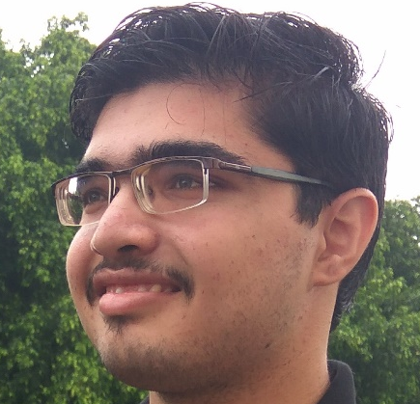
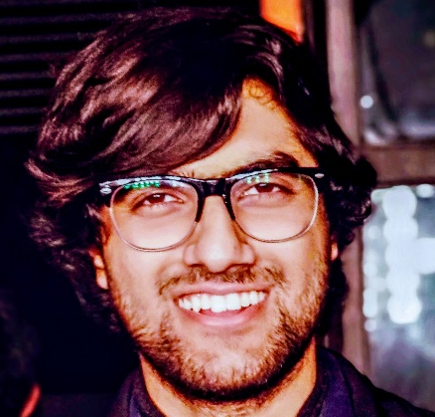
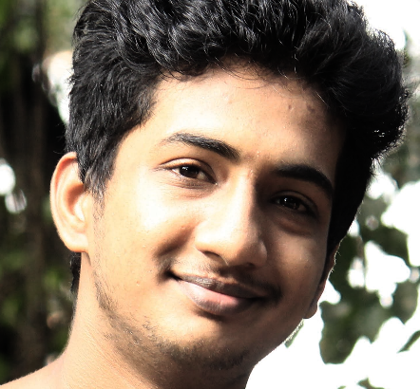
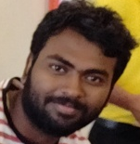
Course Team
Anshul Vijayvergiya (anshulv)
Hindi, English
Parth Sharma (parth)
Hindi, English
Paramkusam Niranjan (niranjan)
Telugu, Hindi, English
Abhisek Panda (apanda)
Oriya, Hindi, English

Slide 4
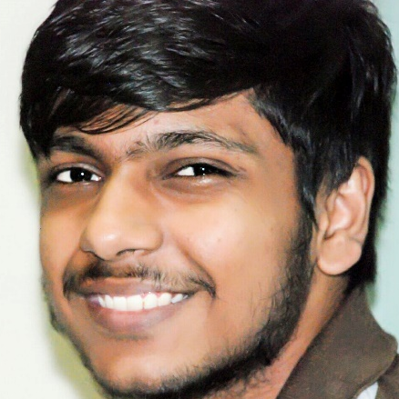

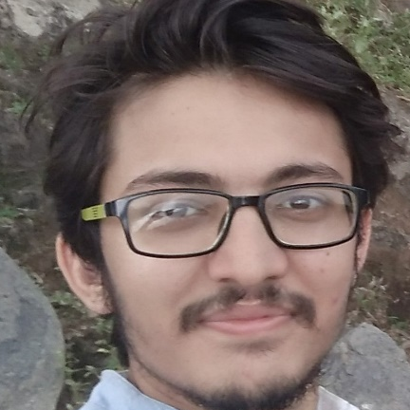
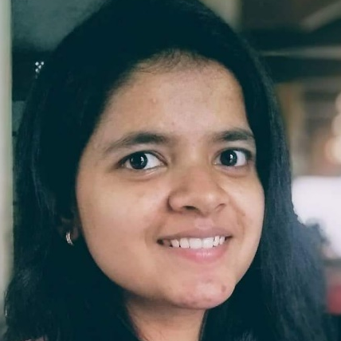
Course Team
Prakhar Agarwal (pkhrag)
Hindi, English
Siddharth Mittal (sidm)
Hindi, English
Sanket Gandhi (sanketg)
Hindi, English
Nikita Awasthi (anikita)
Hindi, English

Slide 5
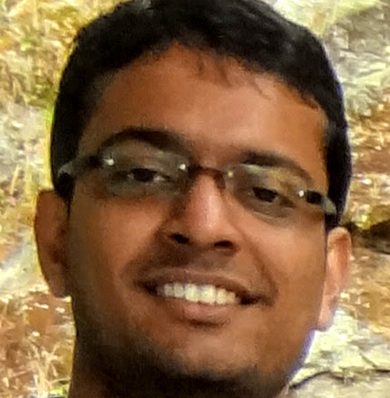
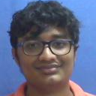

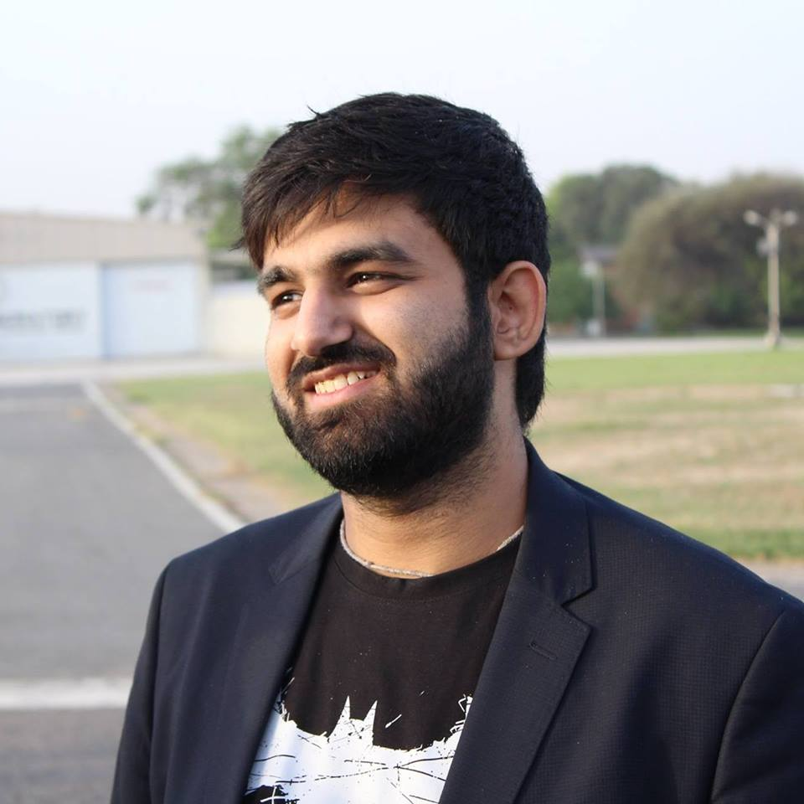
Course Team
Ankit Jalan (ankitj)
Hindi, English
Abhibhav Garg (abhibhav)
Tamil, Hindi, English
Ayush Tulsyan (atulsyan)
Marwari, Hindi, English
Kunal Kapila (kunalkap)
Hindi, English

Slide 6
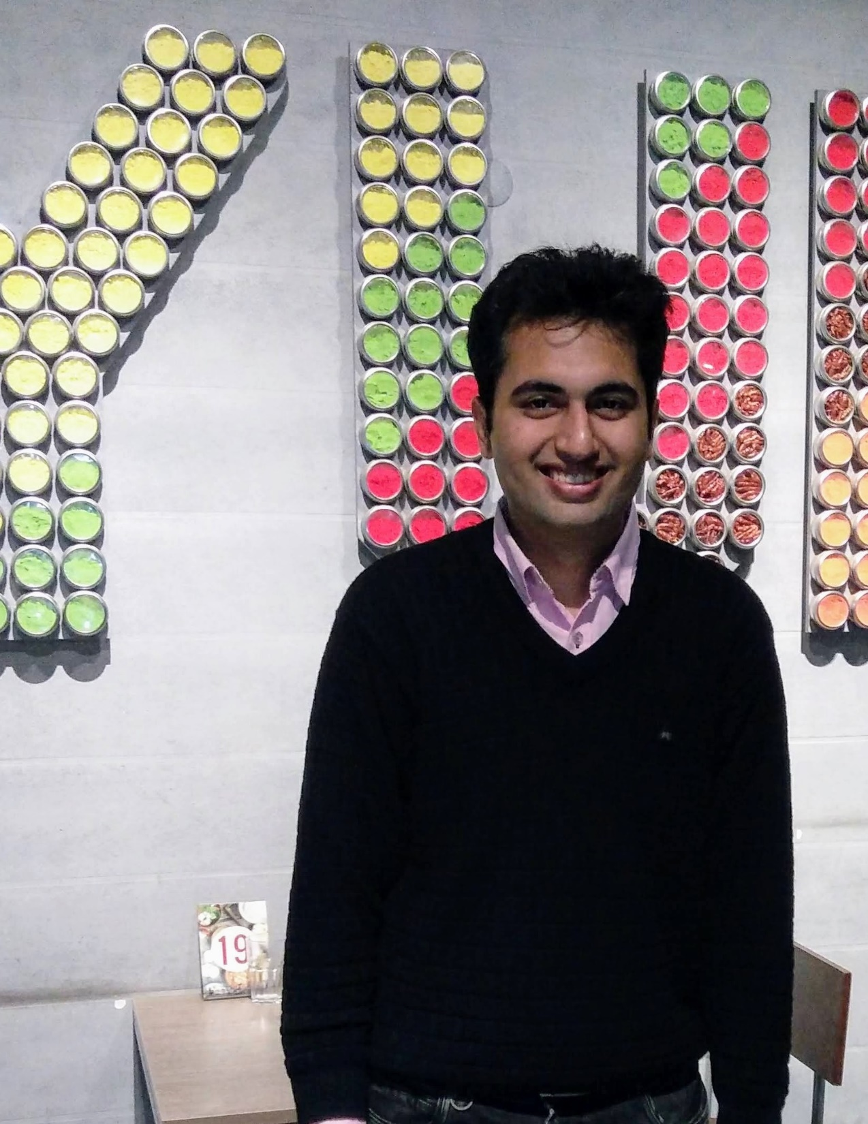
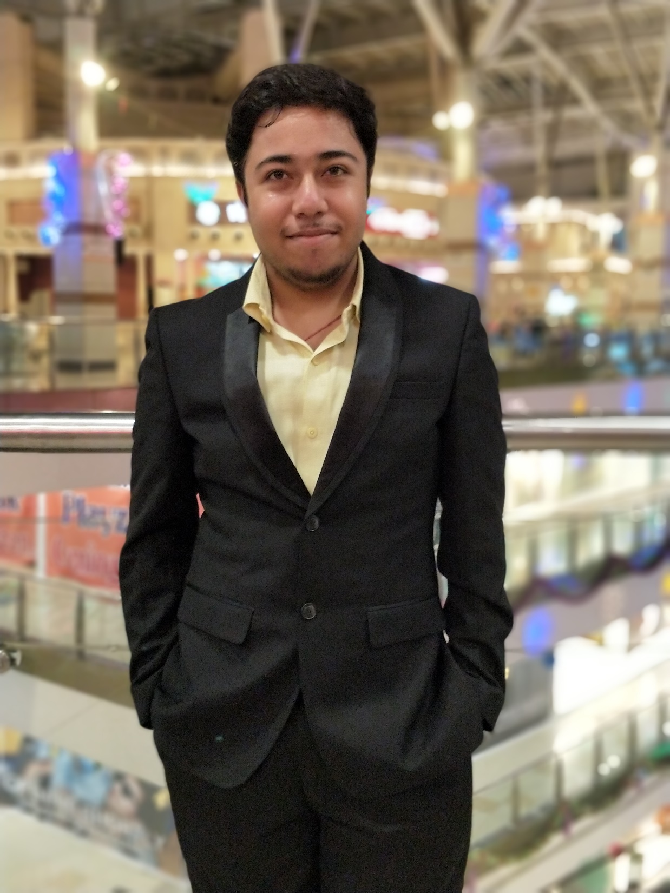
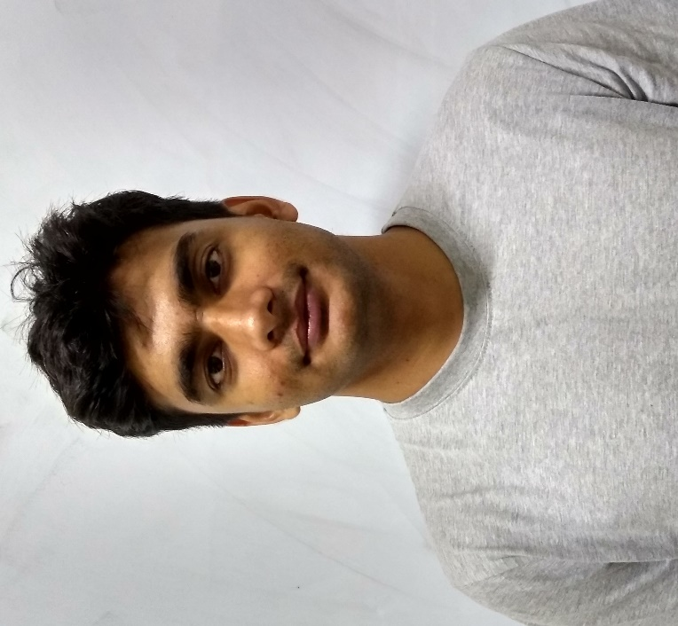
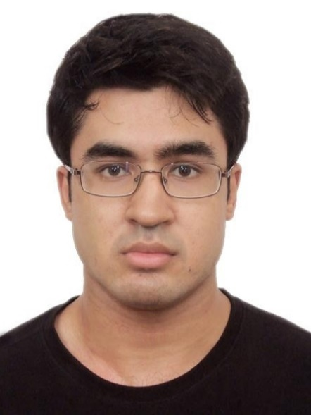
Course Team
Massand Sagar Sunil (smassand)
Gujarati, Hindi, English
Shashank Shekhar (sshekhar)
Hindi, English
Bhaskar Mukhoty (Admin)
Bangla, Hindi, English
Purushottam Kar (Instructor)
Bangla, Hindi, English

